Slide 1
Controlled Experiments
Dirk Riehle, Univ. Erlangen
NYT C11
Licensed under CC BY 4.0 International

Slide 2
Some Section
Definition of controlled experiment
An experiment is an orderly procedure carried out with the goal of verifying, refuting, or establishing the validity of a hypothesis [WP]
A controlled experiment is an experiment with the procedure set-up to measure the relationship between an independent and a dependent variable
Uses of controlled experiments
For both human subjects and non-human phenomena
Can be used where reflection is not available
Pros and cons
Requires a highly restricted environment

Slide 4
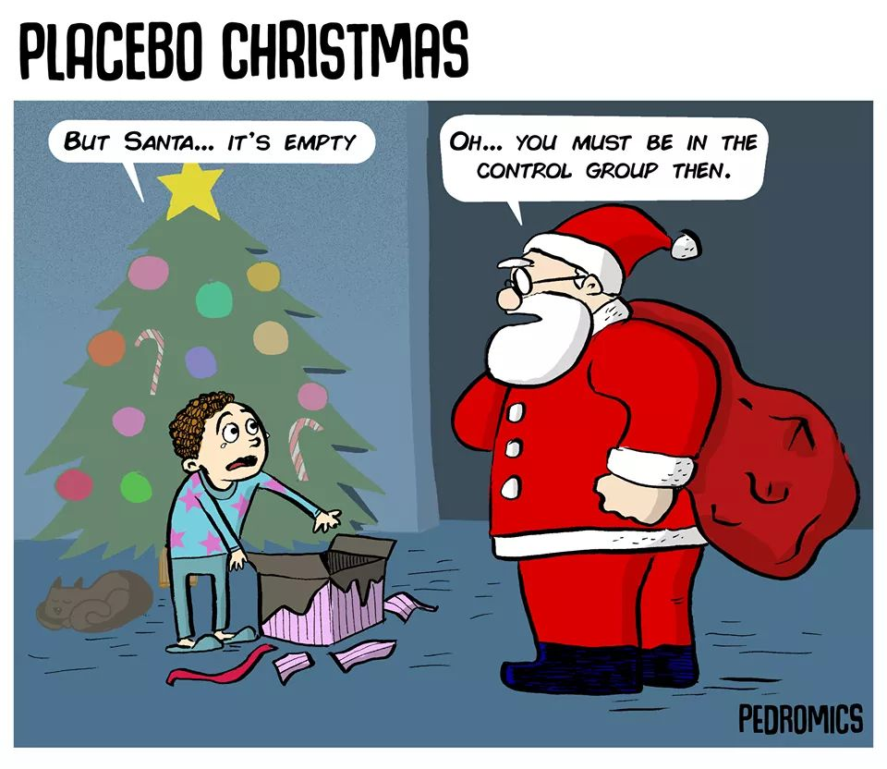

Slide 5
First Slide
Top line
First bullet item
Second bullet item

Slide 6
Thank you! Any questions?
dirk.riehle@fau.de – https://oss.cs.fau.de
dirk@riehle.org – https://dirkriehle.com – @dirkriehle

Slide 7
Legal Notices
License
Licensed under the CC BY 4.0 International license
Copyright
© Copyright 2022 Dirk Riehle, some rights reserved

